Slide 1
USA Election | data analysis
An Analysis on the US Presidential Election from 2012 to 2016
Team:
Badr Worrell, Camila Cois, James Tedrow and Mudit Mathur

Slide 2
Research/biases
Hillary Clinton
First Woman President??
First former First Lady??
Experienced/Qualified
Political
Scandal ridden
Lacks popularity
Donald Trump
Ultimate political outsider
Businessman, Real Estate Tycoon
Celebrity
Gauche, crude voice of the people
Simple message: America is in a bad place, I can make it great again
Nostalgia
Strategy:
Strategy:
Win woman, Win Hispanic, status quo
Win White, Win middle America

Slide 3
PRIMARY Question
What were shared characteristics, of counties, in the 2012 to 2016 U.S. Presidential elections, that flipped from Barack Obama to Donald Trump?

Slide 4
motivation
Why do we care?
With the 2020 Election upcoming, we want to gain insights into what factors went into a win by Trump in 2016
We are interested in how the Electorate College can vault a candidate to victory, even if they lose the Popular Vote
To do this, we want to break down those counties and states that switched from voting Obama to Trump in 2016
More Questions to Explore
How significant was the change in counties that changed their vote from Democrat in 2012 to Republican in 2016?
How polarizing was this election? We feel this could help explain the result.

Slide 5
Data sourcing
What data do we need?
County Election Data 2012 & 2016
County Demographics Data
Education
Economics
Race
Iowa county map
What data is available?
County Presidential Election Returns 2012 & 2016
Election results for all 3,142 Counties/Parishes/Boroughs/10 census areas/41 independent cities, and the District of Columbia
USA 2016 Presidential Election by County 2016
Election results for all 3,142 counties with demographic data for each county
Income data
Iowa geodata DataSet
County Boundaries for the state of Iowa

Slide 6
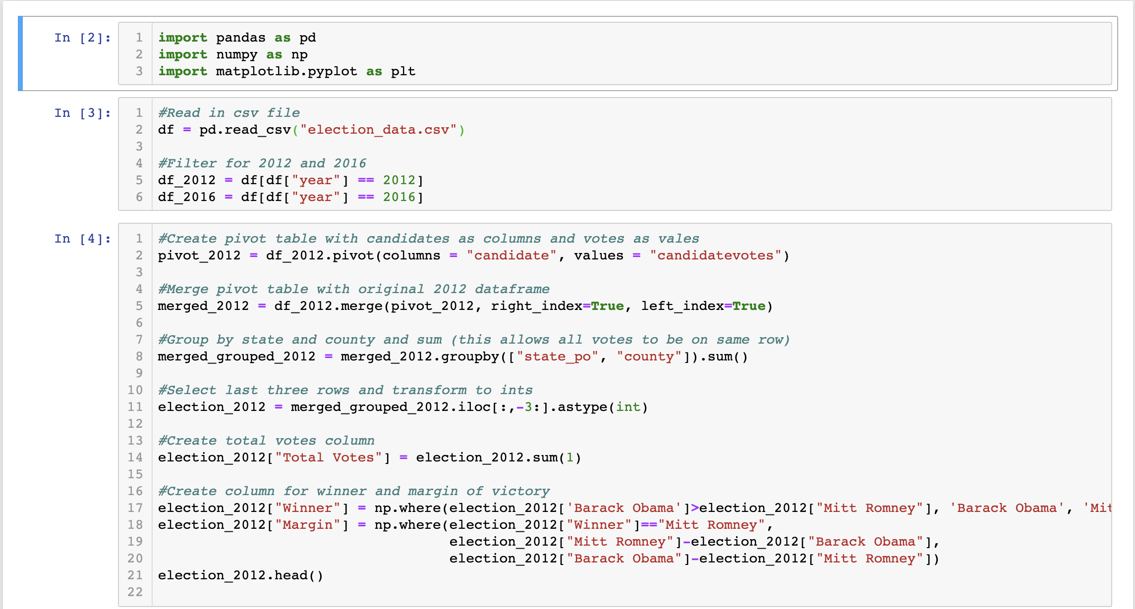
Data wrangling | Election Results 2012

Slide 7
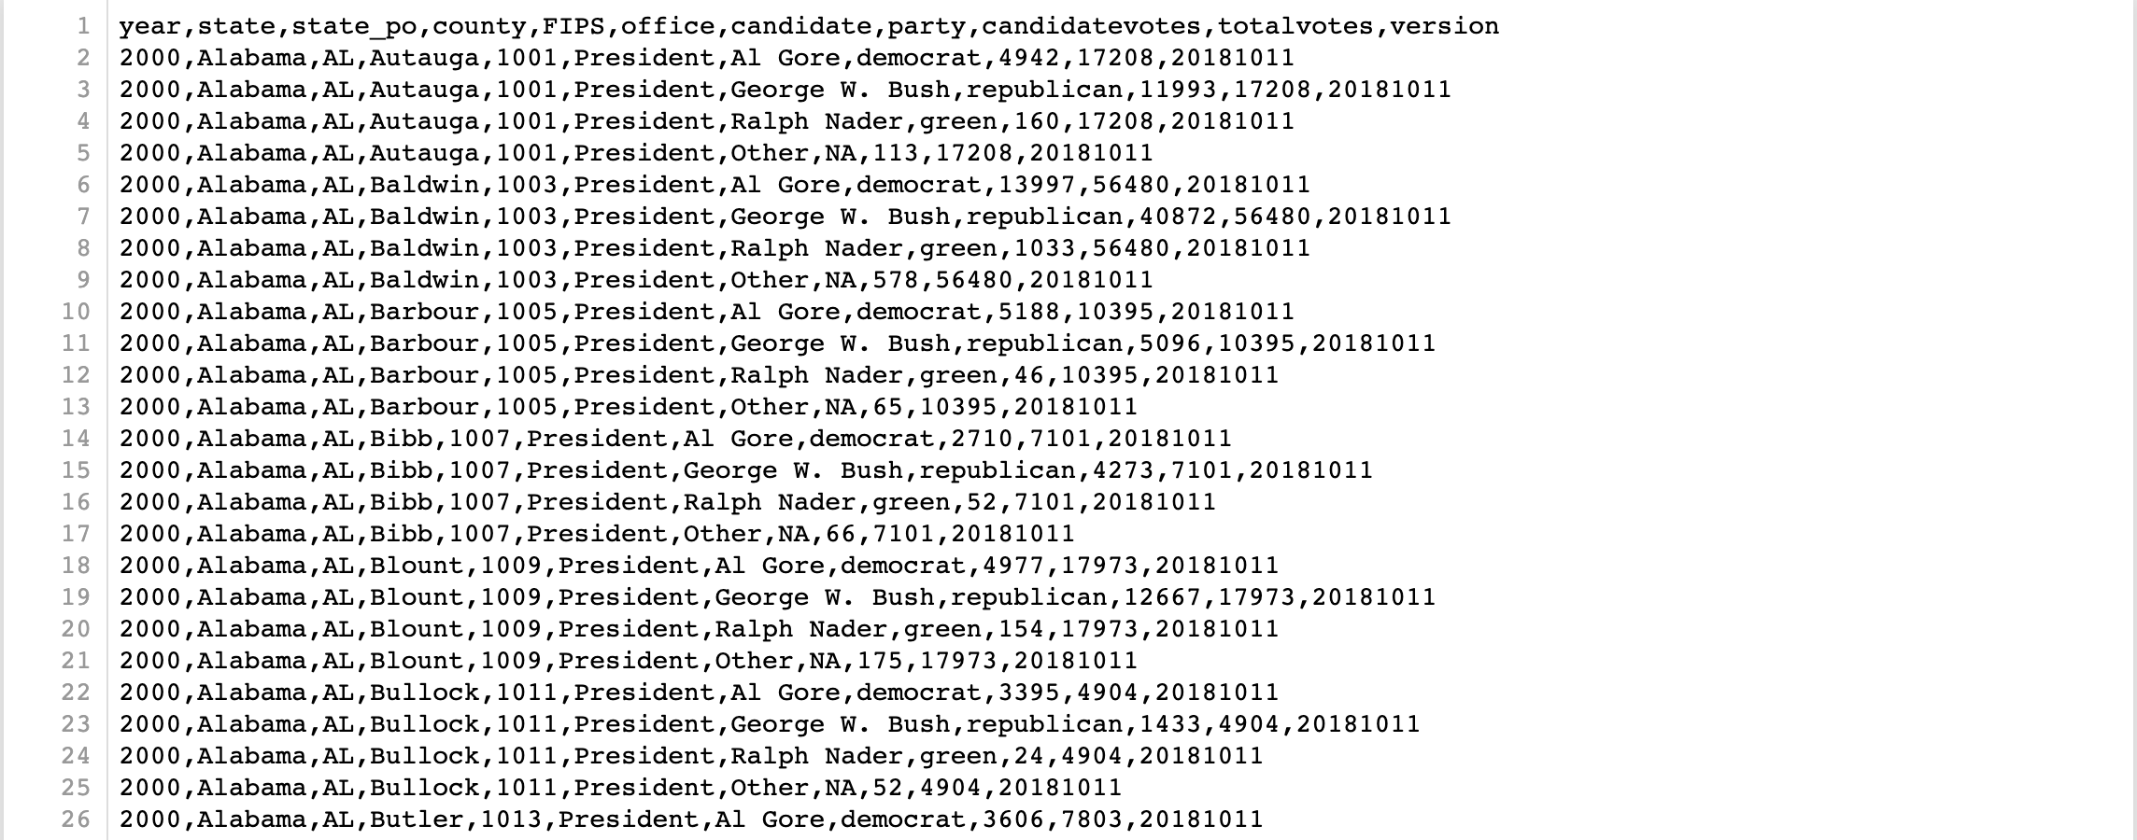
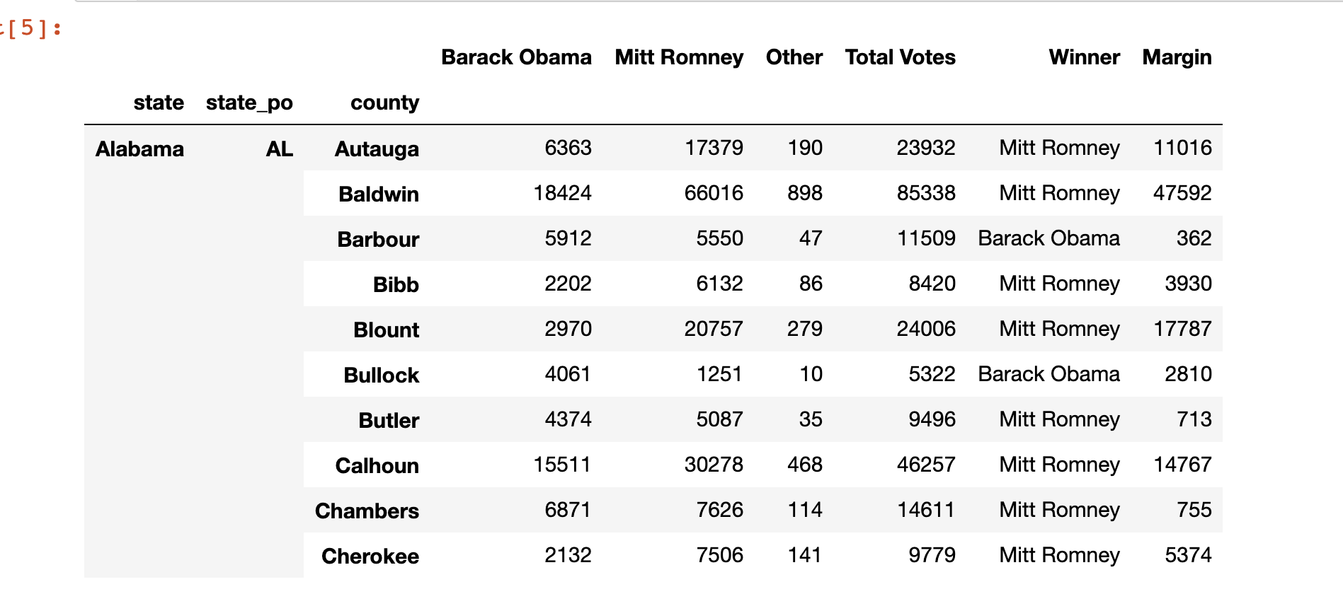
Before
After
Figure 2: Election Data 2012
Figure 1: 2000 – 2016 Election Data CSV File

Slide 8
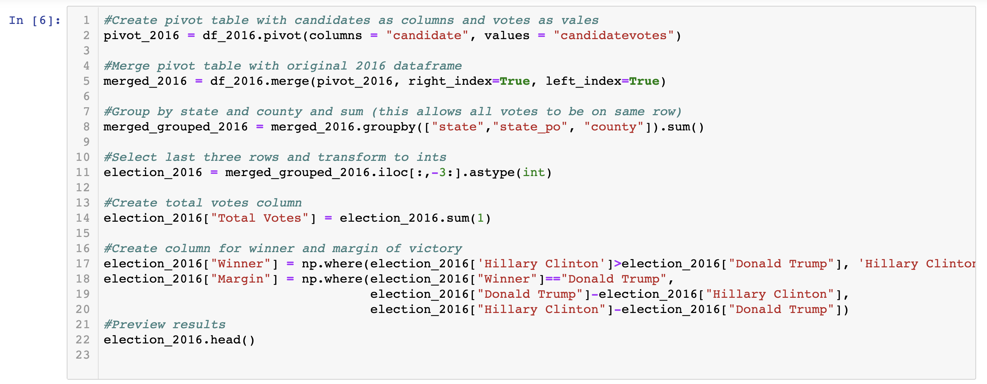
Data Wrangling | election results 2016

Slide 9
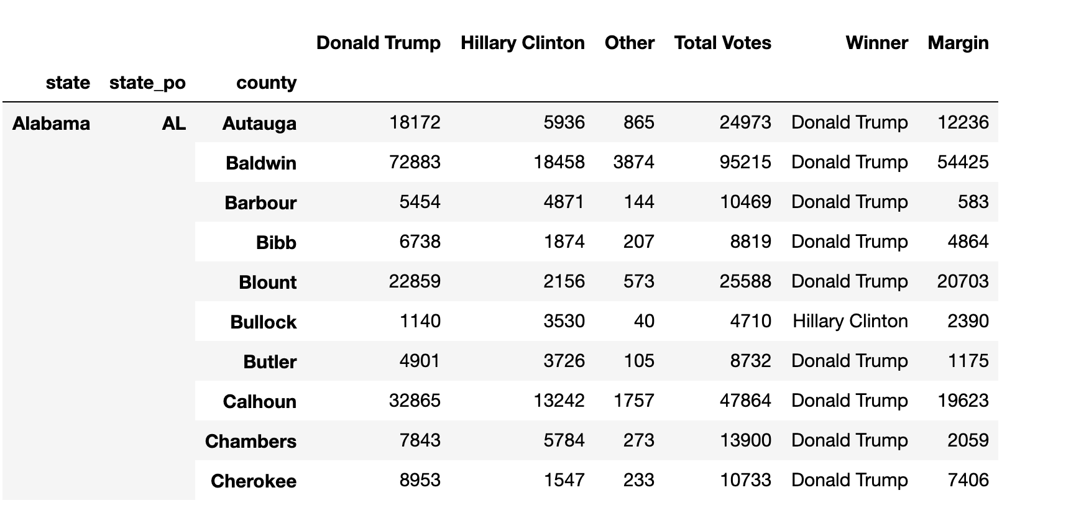
Election Data 2016 Df

Slide 10
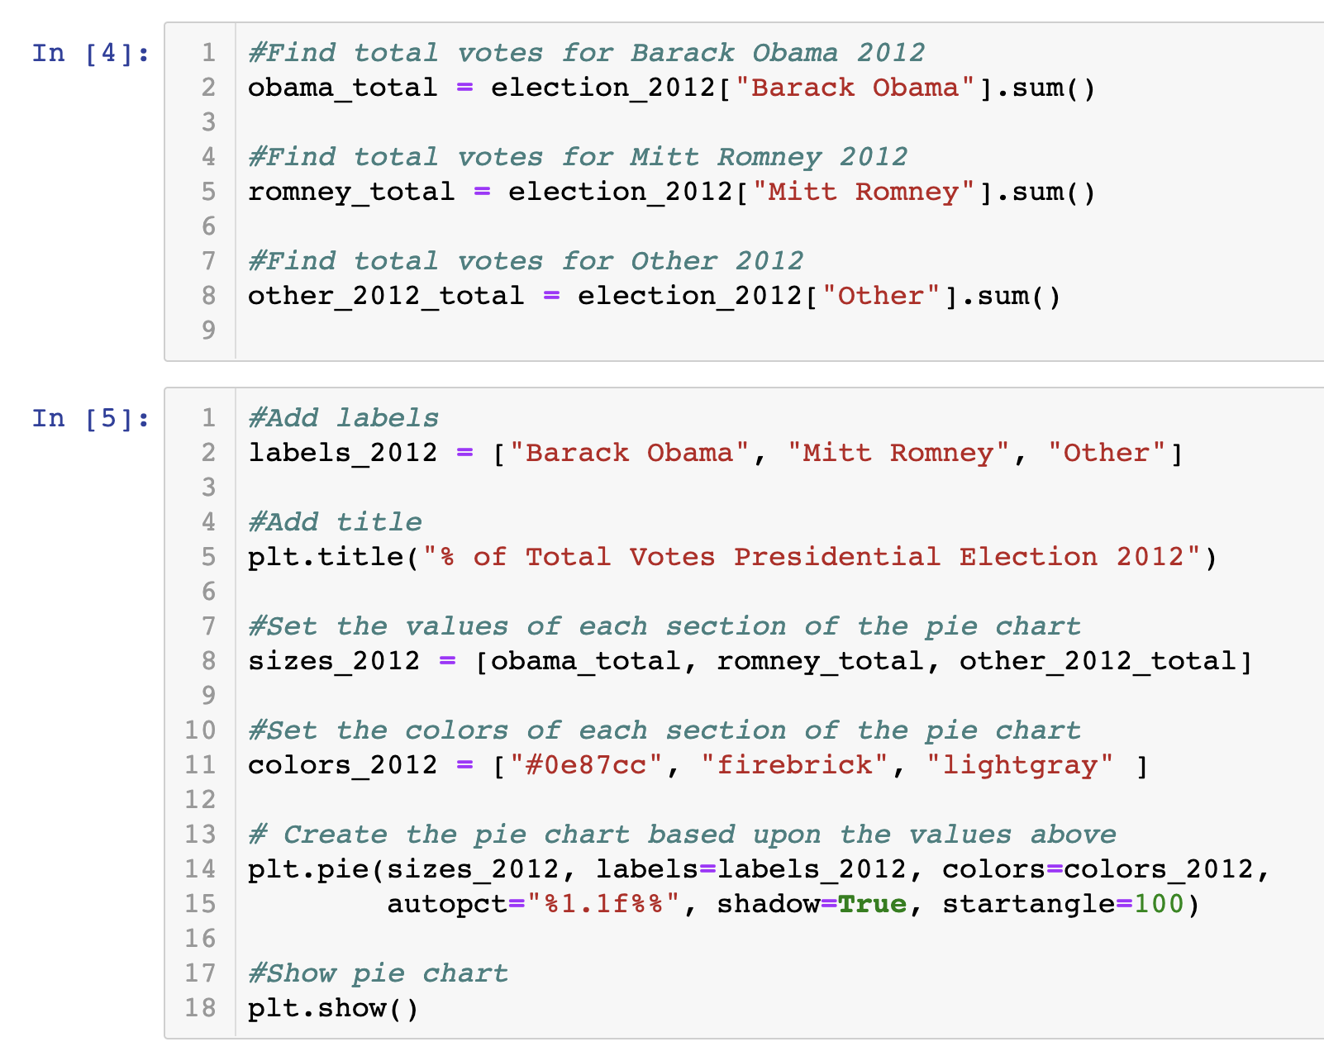
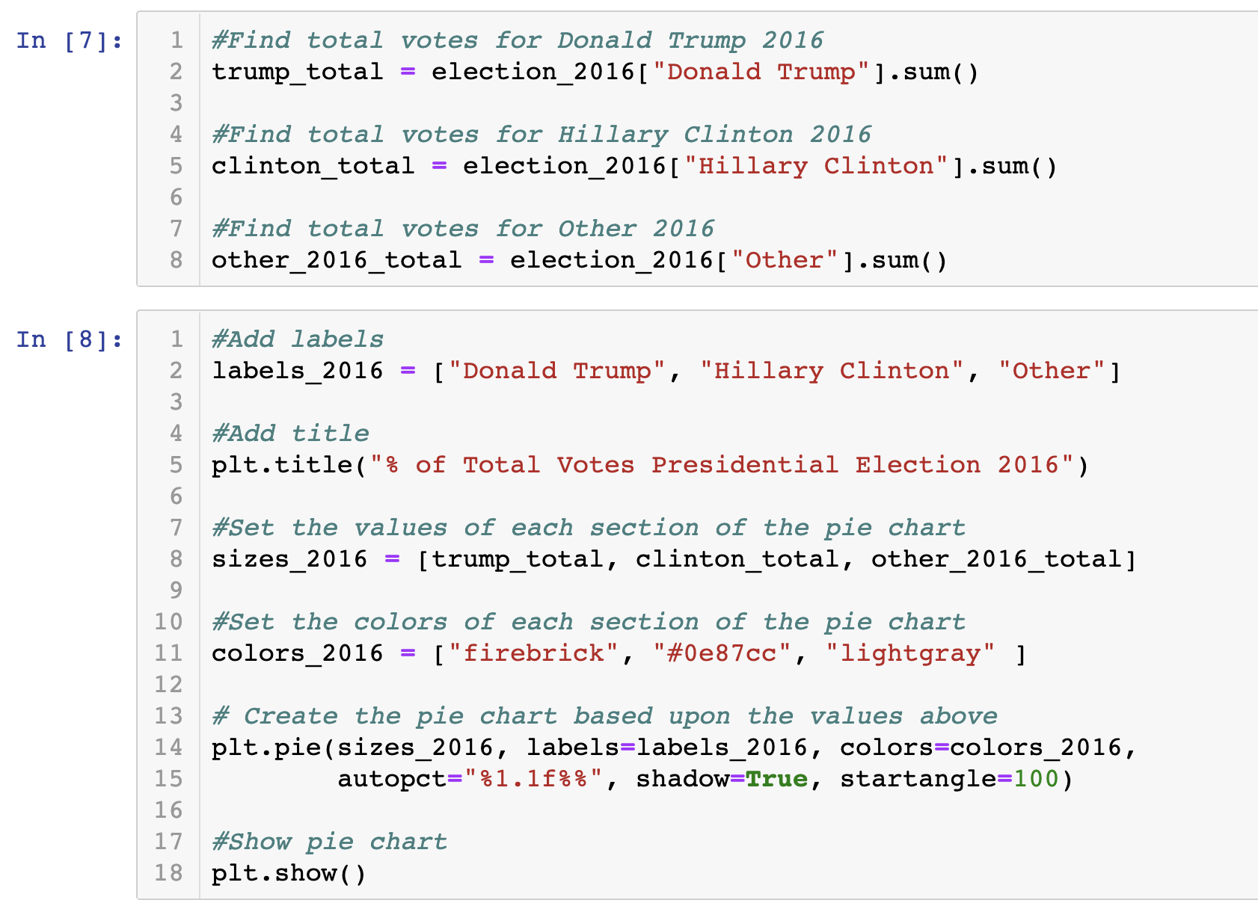
Pie Charts 2012 & 2016 - code

Slide 11
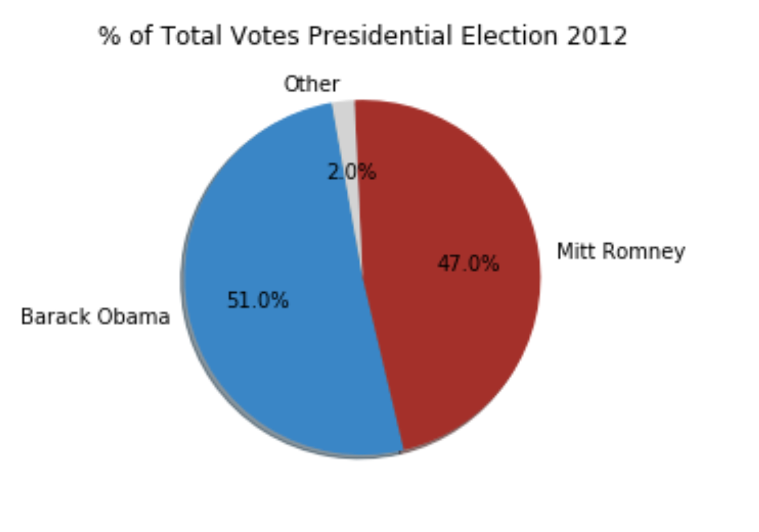
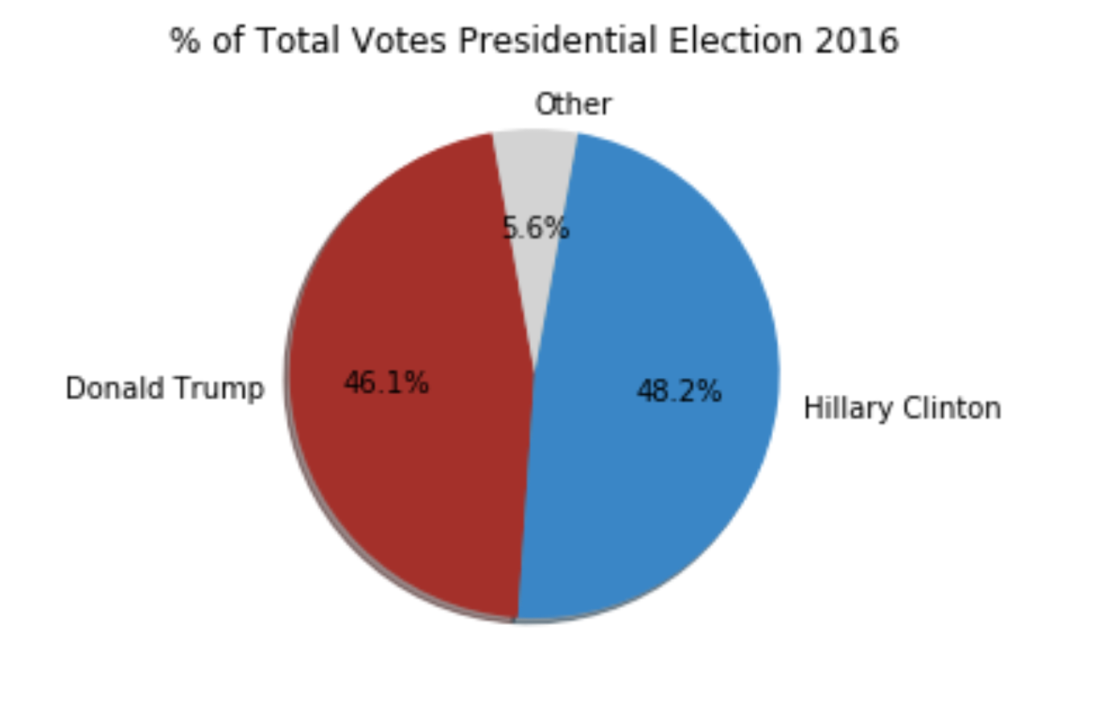
Pie Charts 2012 & 2016 - Visual

Slide 12
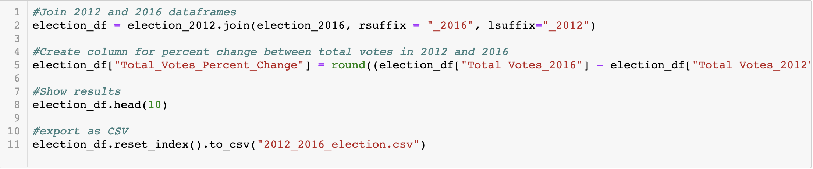
Data Merge | 2012 & 2016

Slide 13
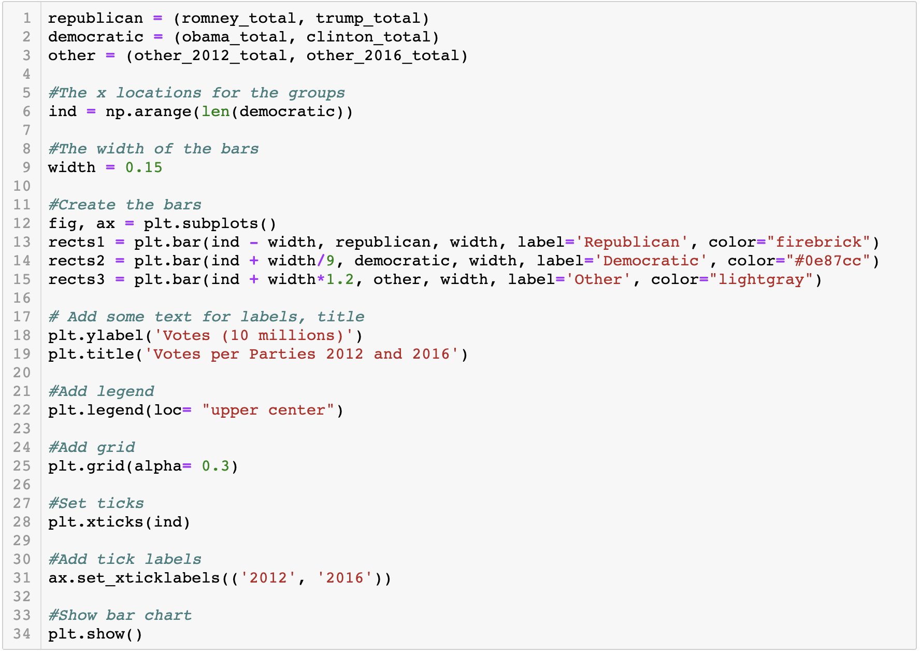
Bar Graph 2012 & 2016 - Code

Slide 14
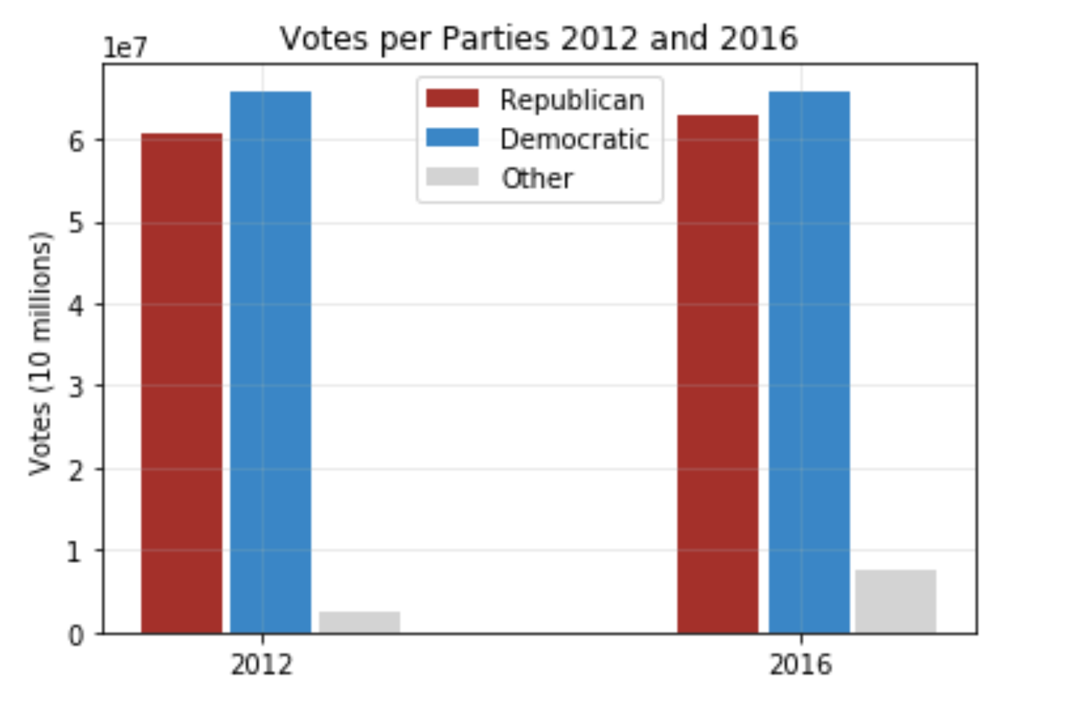
Bar Graph 2012 & 2016 - Visual

Slide 15
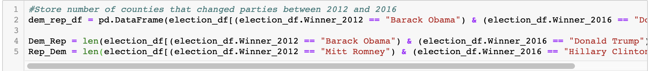
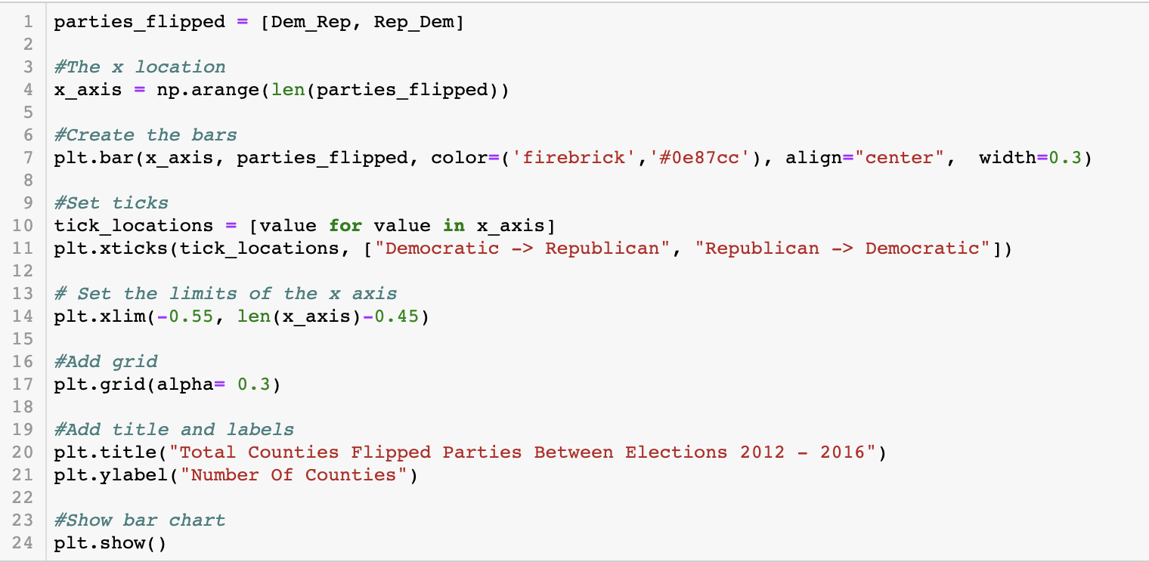
Bar Graph | Swing Counties - Code

Slide 16
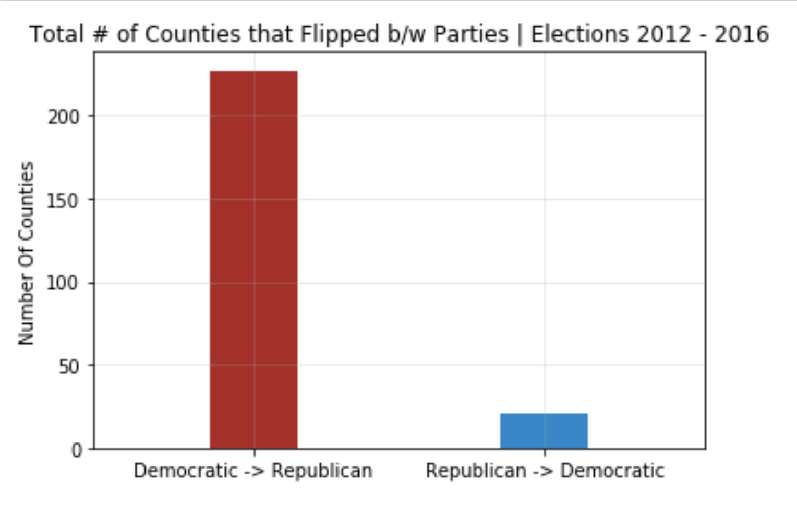
Total # of Counties that Flipped - Visual

Slide 17
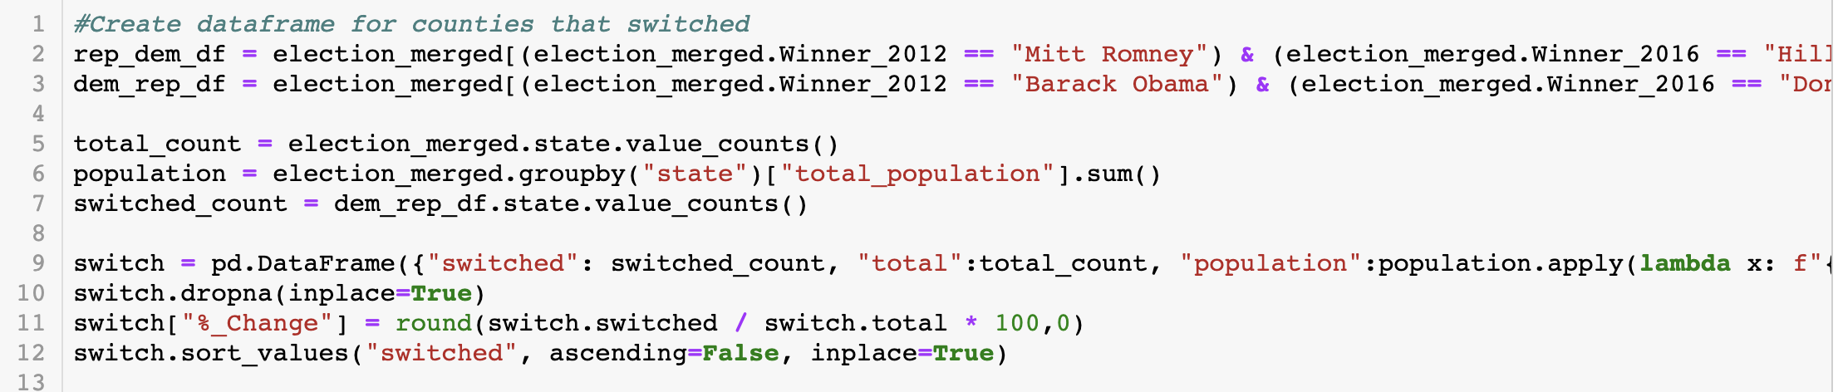
Total # of Counties that Flipped - Code

Slide 18
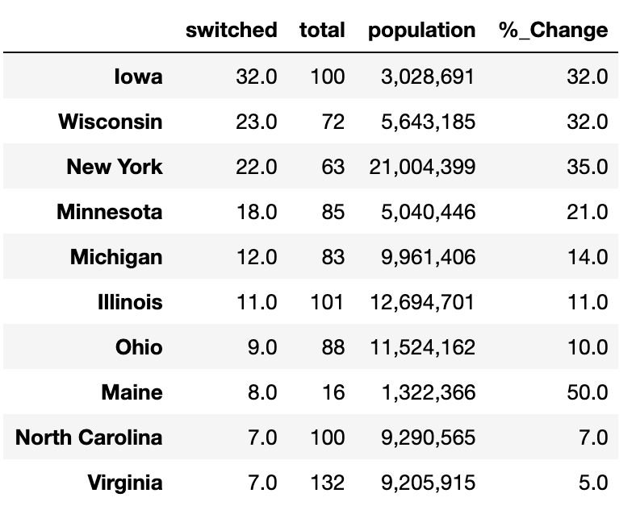
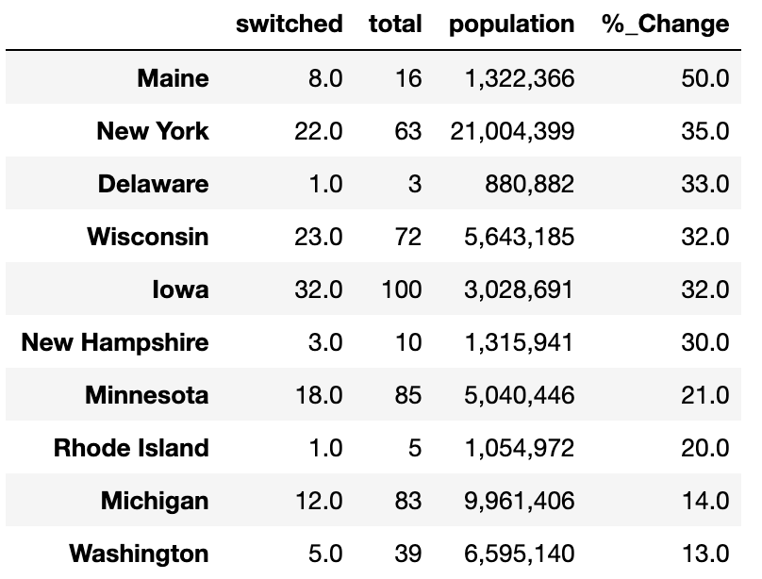
Counties that Flipped Dem. To Rep - Table
Table 1: Top Ten States with the most “Flipped” Counties
Table 2: Top Ten States with the largest % Change in “Flipped” Counties

Slide 19
Election map | Context
TRUMP SWING STATES 2016:
PA – 20
OH – 18
MI – 16
WI – 10
IA – 6
AZ – 11
FL – 29
NC – 15
CLINTON SWING STATES 2016
CO – 9
NV - 6
NH – 4
VA – 13

Slide 20
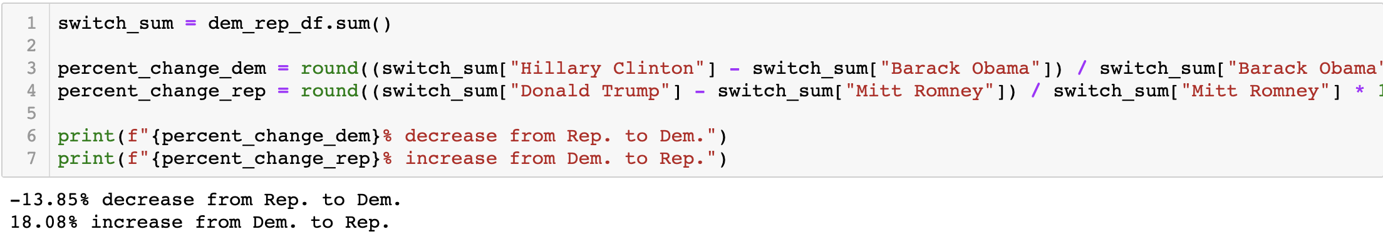
Percentage change in Counties that Flipped

Slide 21
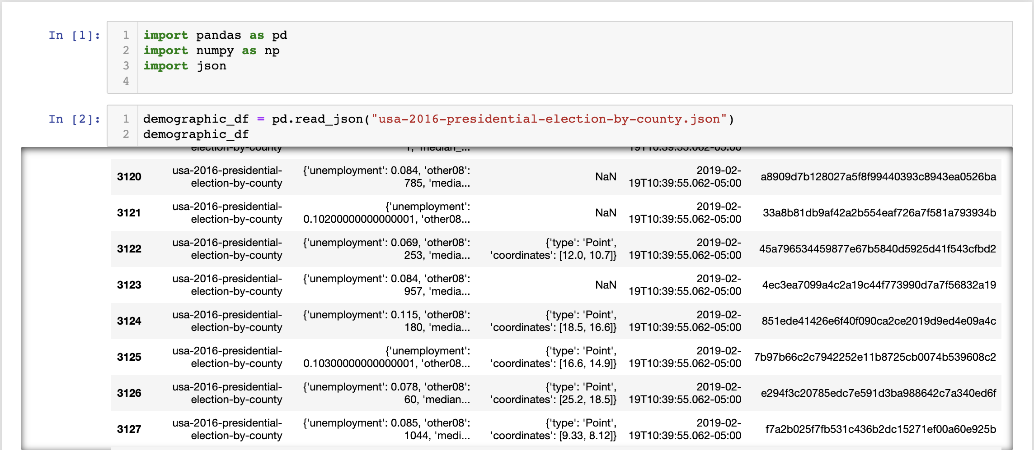
Data Strangling | Demographics

Slide 22
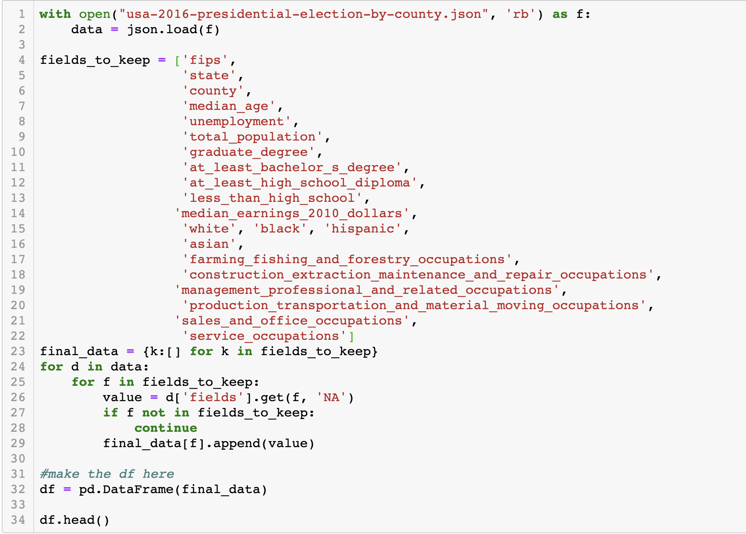
DATA Wrangling | demographics

Slide 23
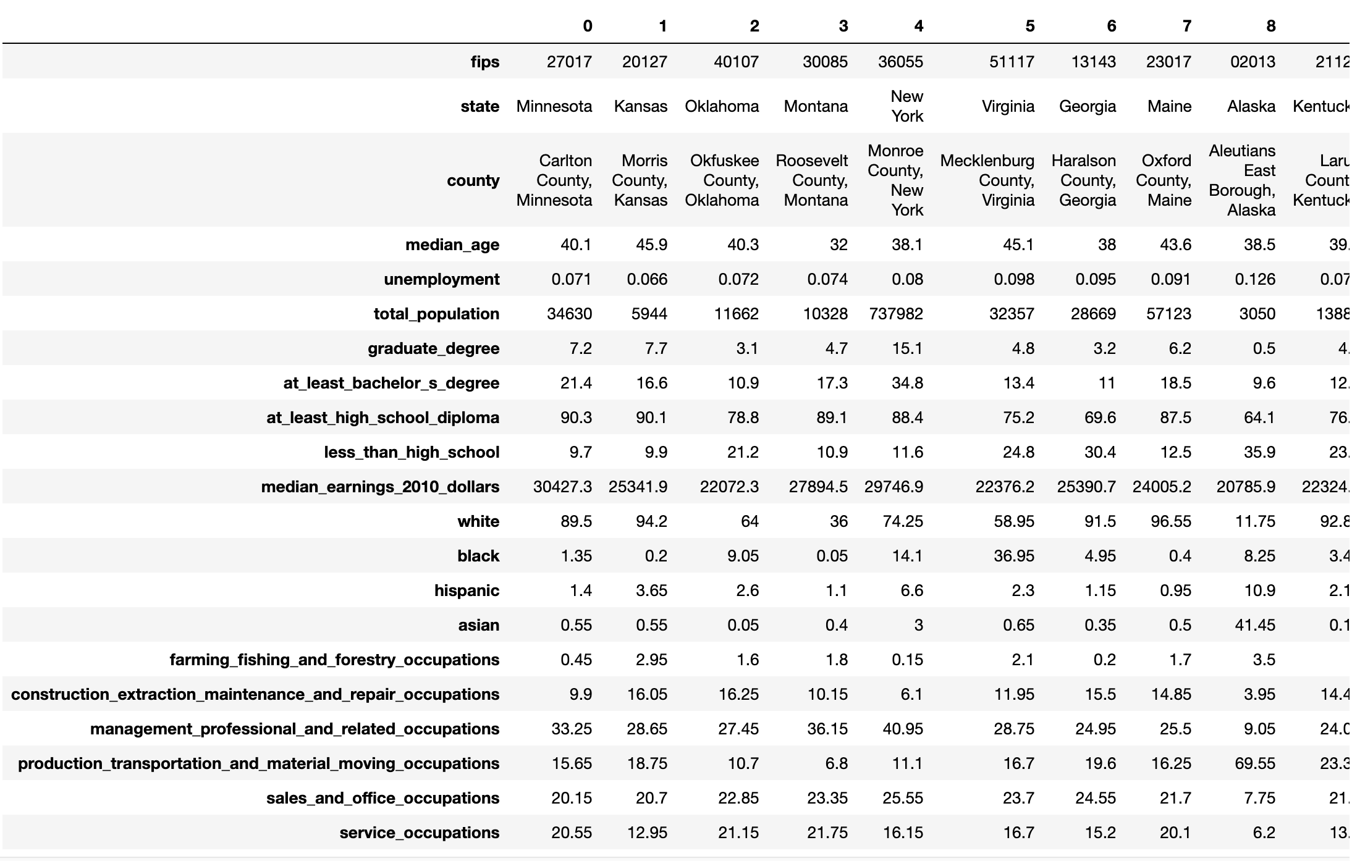
DATA Wrangling | demographics

Slide 24
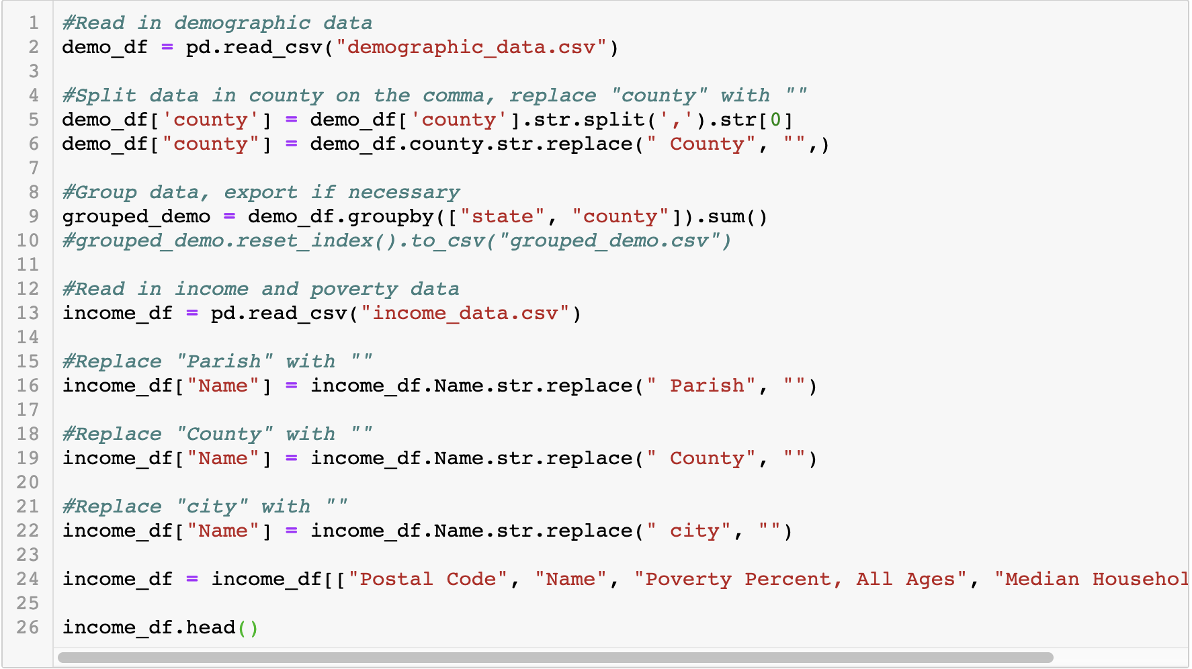
Data Clean | Election data x demographics

Slide 25
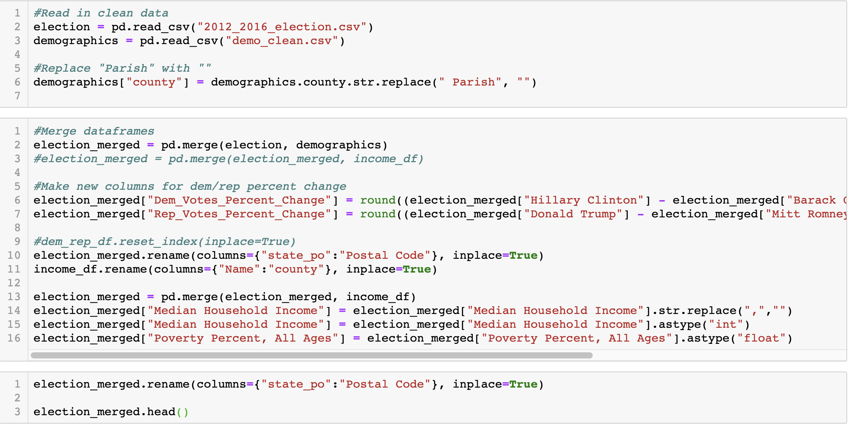
Data Clean | Election data x demographics

Slide 26
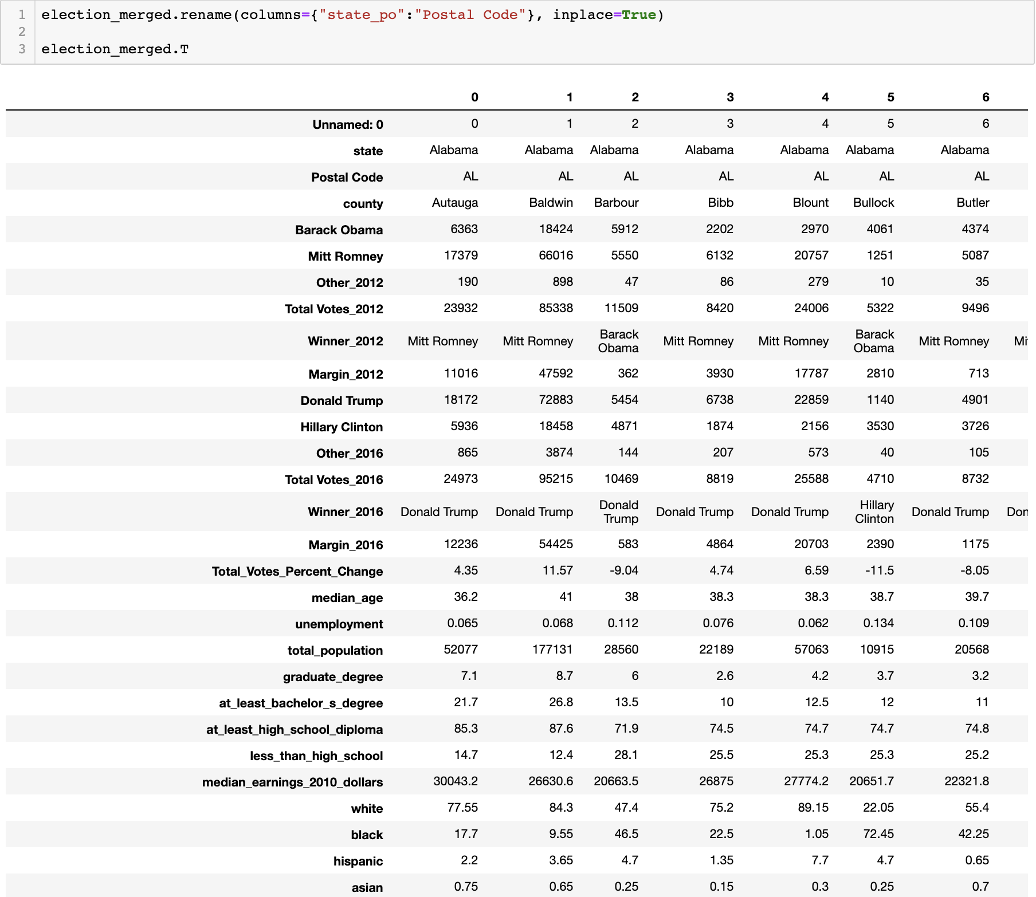
Data Merge | Election data x demographics

Slide 27
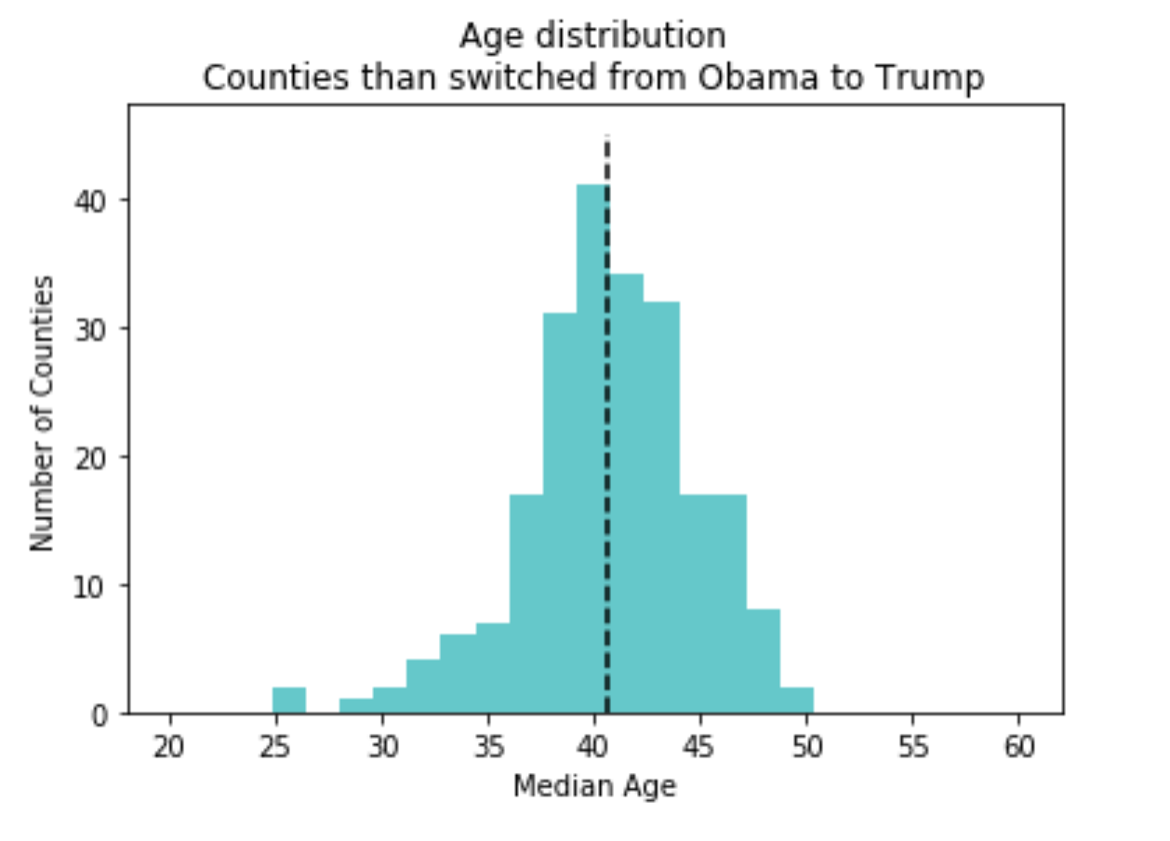
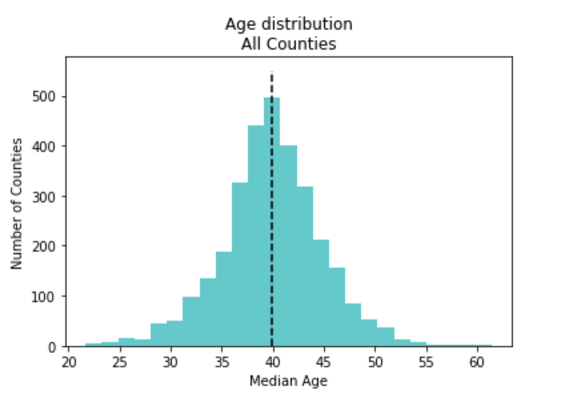
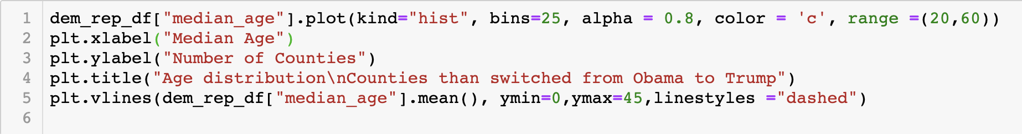
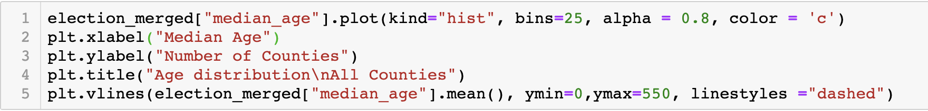
Election data x demographics – AGE Distribution

Slide 28
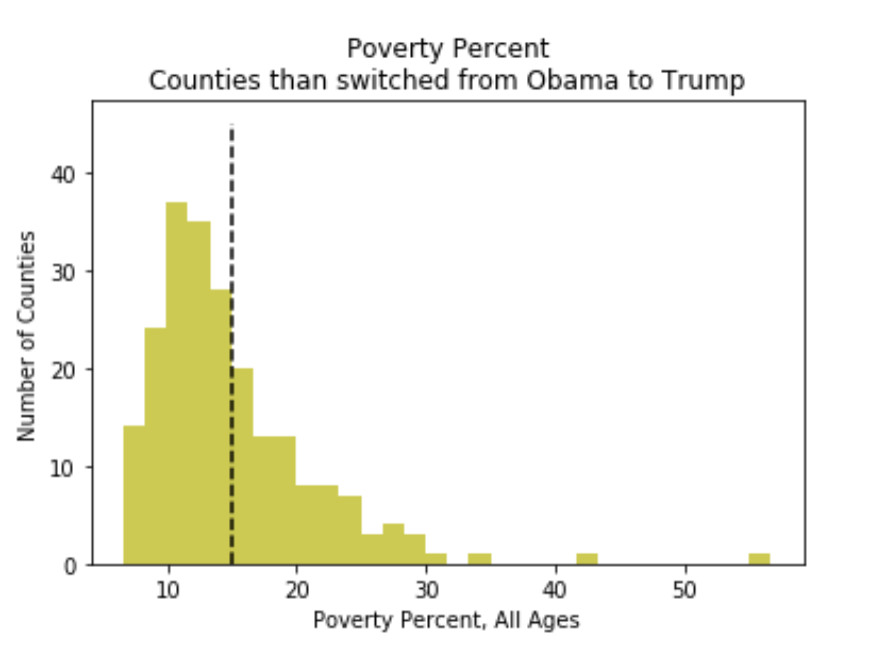
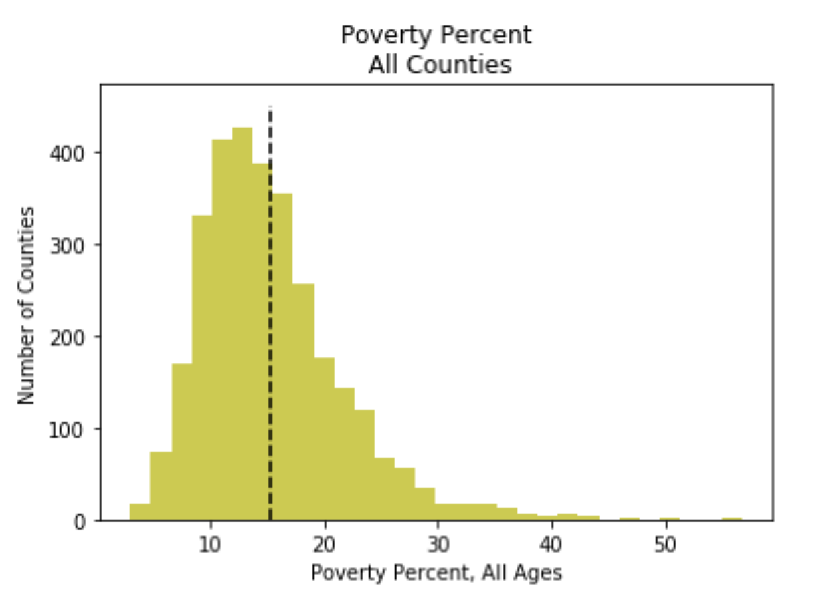
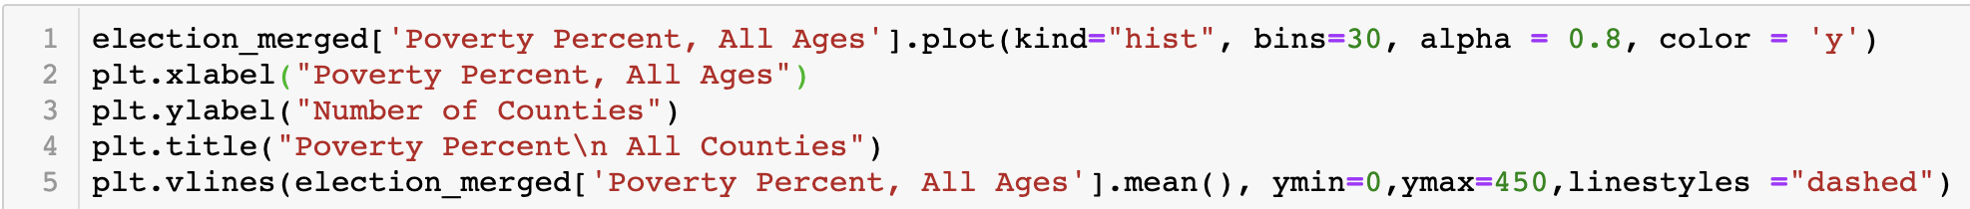
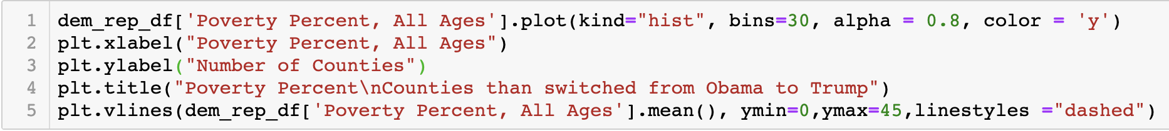
Election data x demographics

Slide 29
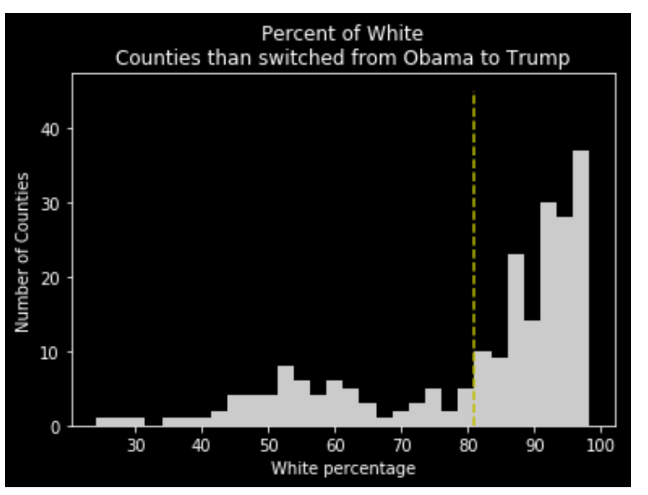
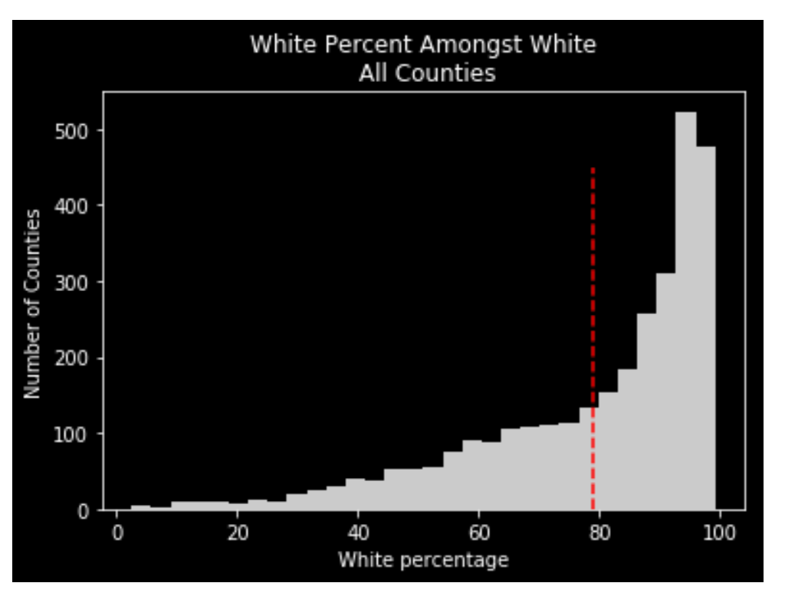
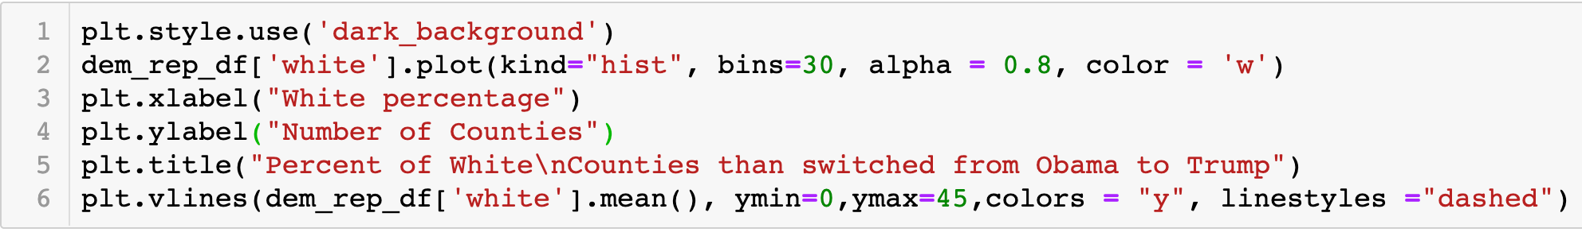
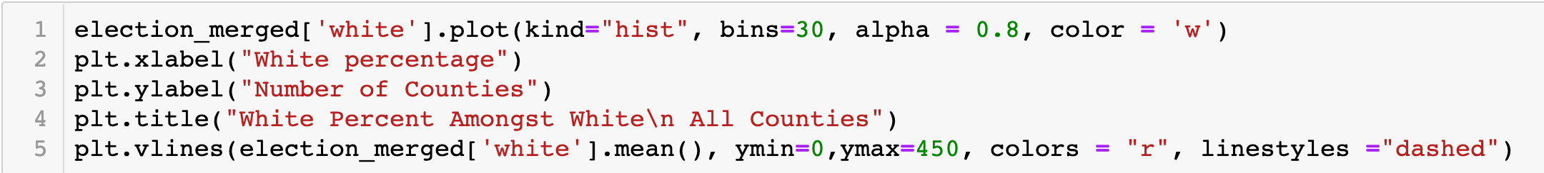
Election data x white demographic

Slide 30
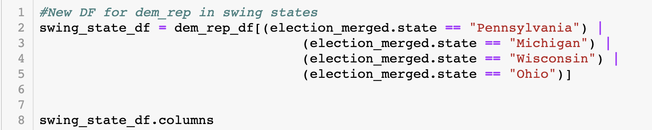
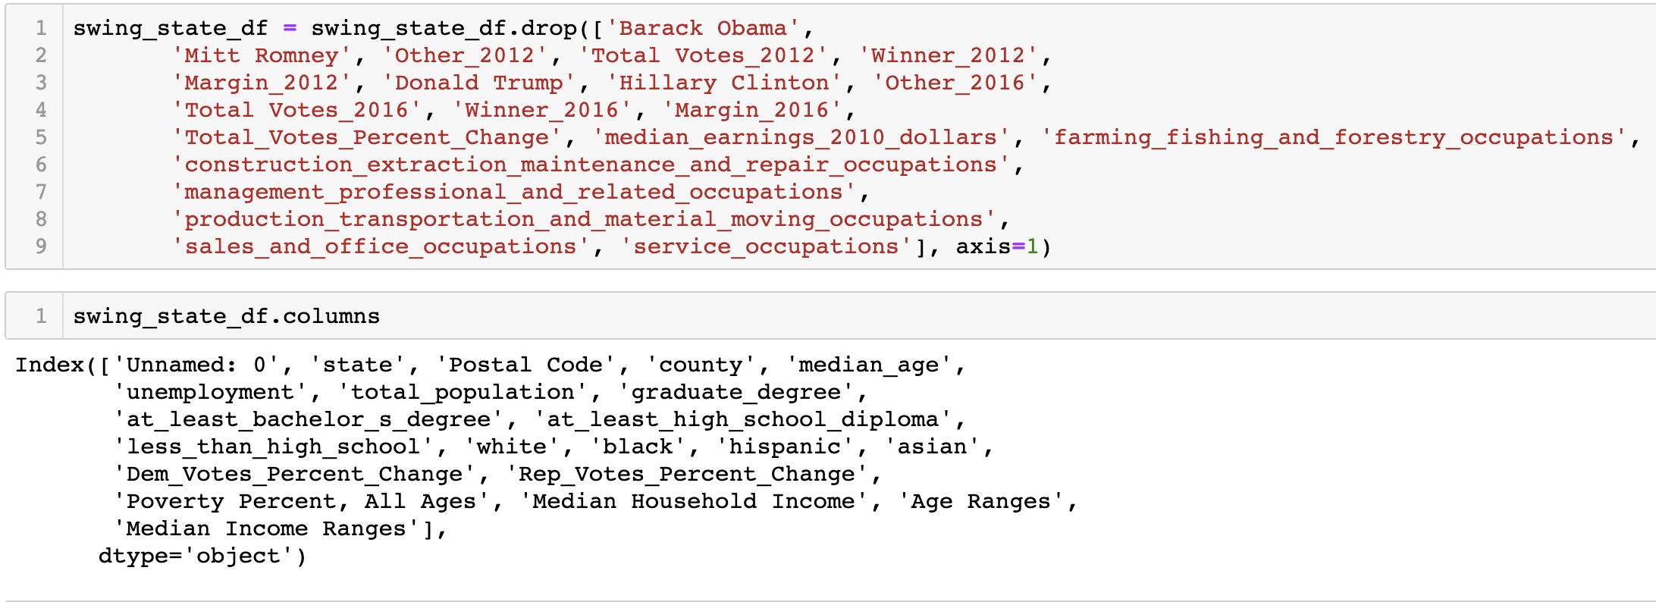
Election data x demographics

Slide 31
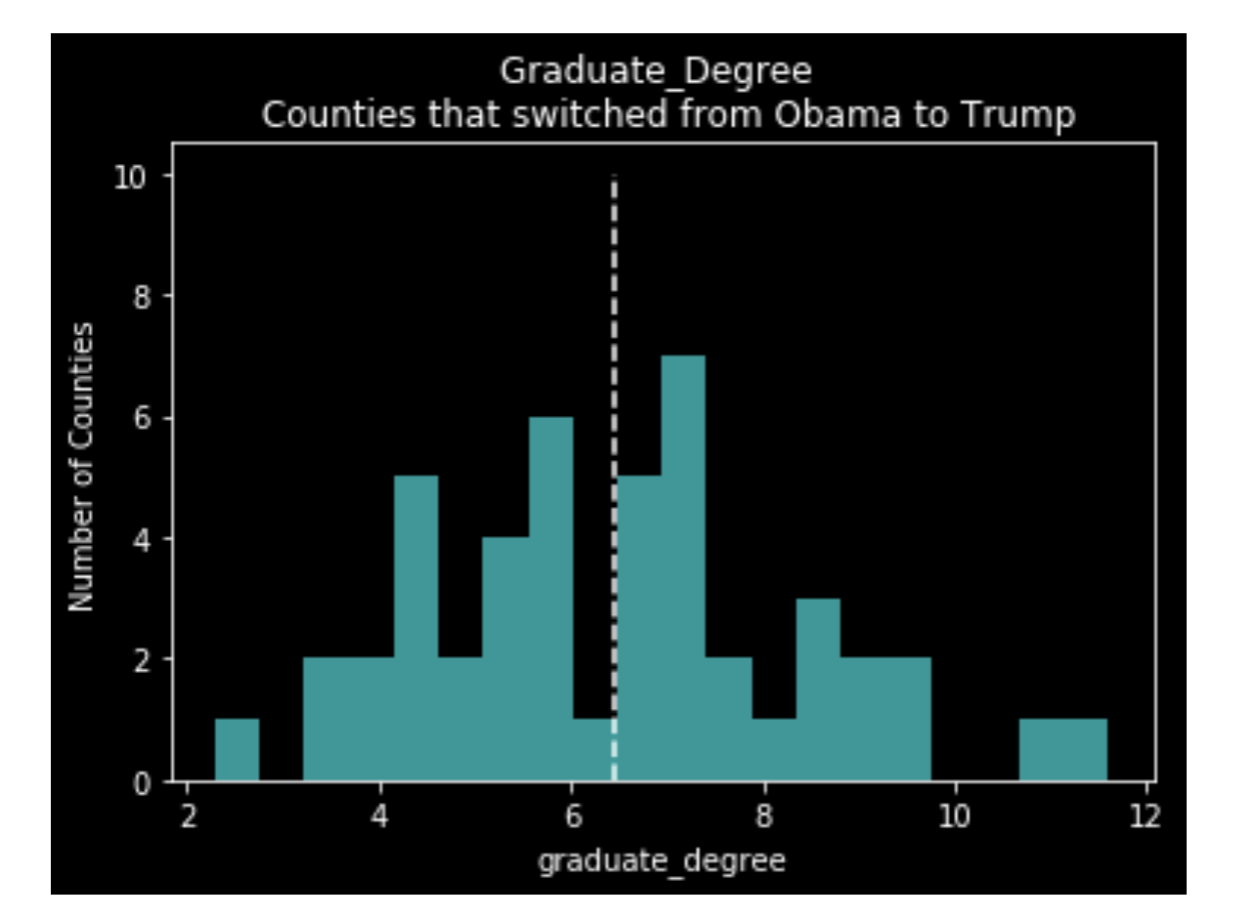
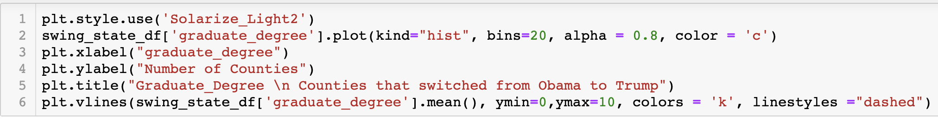
Election data x demographics – Swing States

Slide 32
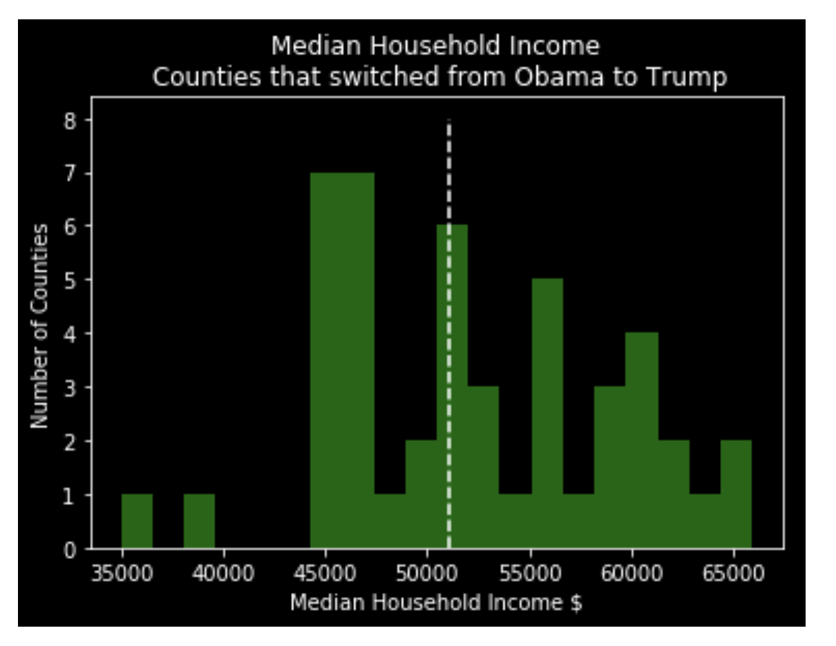
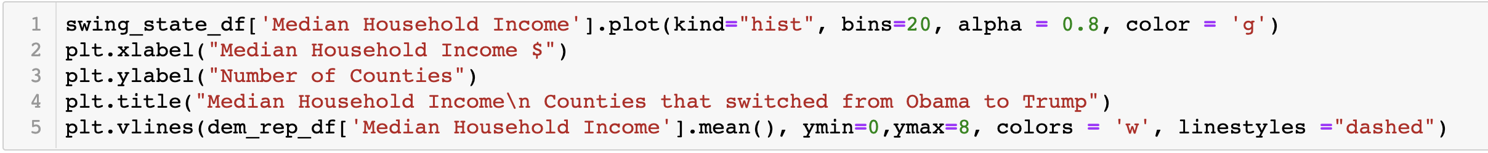
Election data x demographics – swing states

Slide 33
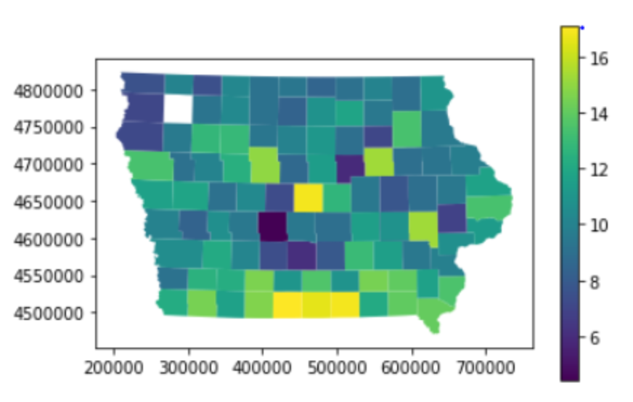
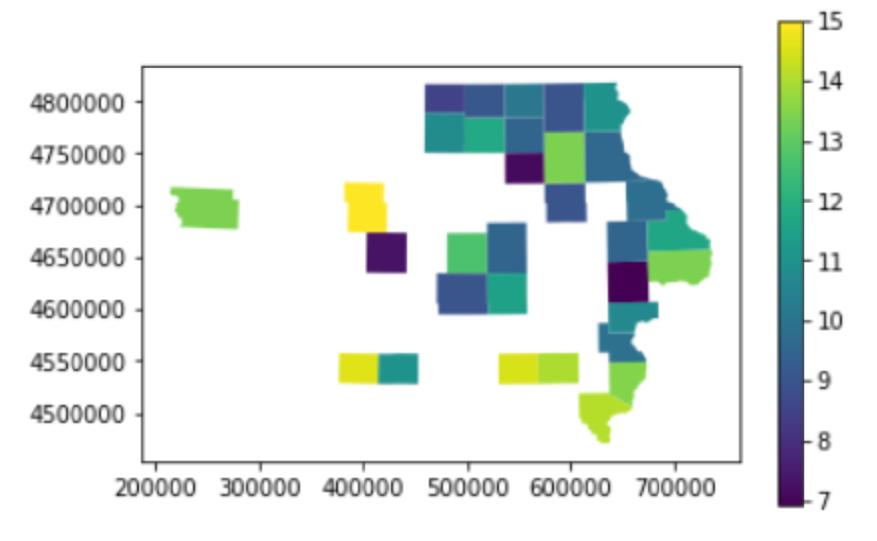
IOWA POVERTY PERCENTAGE BY COUNTY
Poverty % by county in Iowa
Poverty % by Switched Counties in Iowa

Slide 34
Conclusions
The elections in 2012 and 2016 have been VERY close.
The higher number of “Other” votes indicated that 2016 election was highly polarized.
Voter turnout factored into the results as well (would like to have explored this further).
Trump won in many counties from swing states that were previously won by Obama.
Data from demographics and targeted messaging will play a key factor to the result in the 2020 US Elections as well.

Slide 35
Looking ahead
We found difficulties from unwrapping a lot of intricate data sources, such as the csv file with demographic information from the Census, we had to really break the structure of the data to get this right!
We would have liked to explore the catalyst behind the counties that changed their vote from Obama to Trump in a battleground state such as Iowa
Given more time, we would have liked to plot the cities on a map in which Trump and Hillary campaigned in several battleground states, against the voting result of nearby counties. We would then create a formula to denote the impact holding rallies and speeches in such cities impacted the result of the surrounding counties (similar to Least Squares).

Slide 36

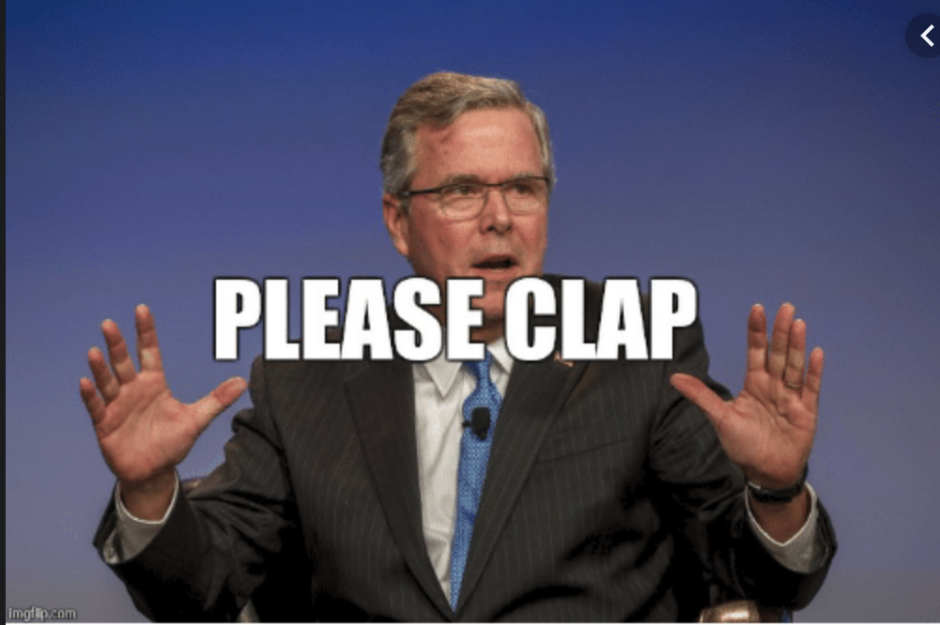
THE END

